Slide 1

Into to Concurrency in
Operating Systems
Igor Syrytsin
15-04-2024

Slide 2
OVERSIGT
INTRODUCTION TO CONCURRENCY
UNDERSTANDING THREADS AND PROCESSES
CONCURRENCY CHALLENGES
PRACTICAL APPLICATIONS OF CONCURRENCY
CONCLUSION AND KEY TAKEAWAYS
IGOR SYRYTSIN, CAOS, SW4 2024

Slide 3
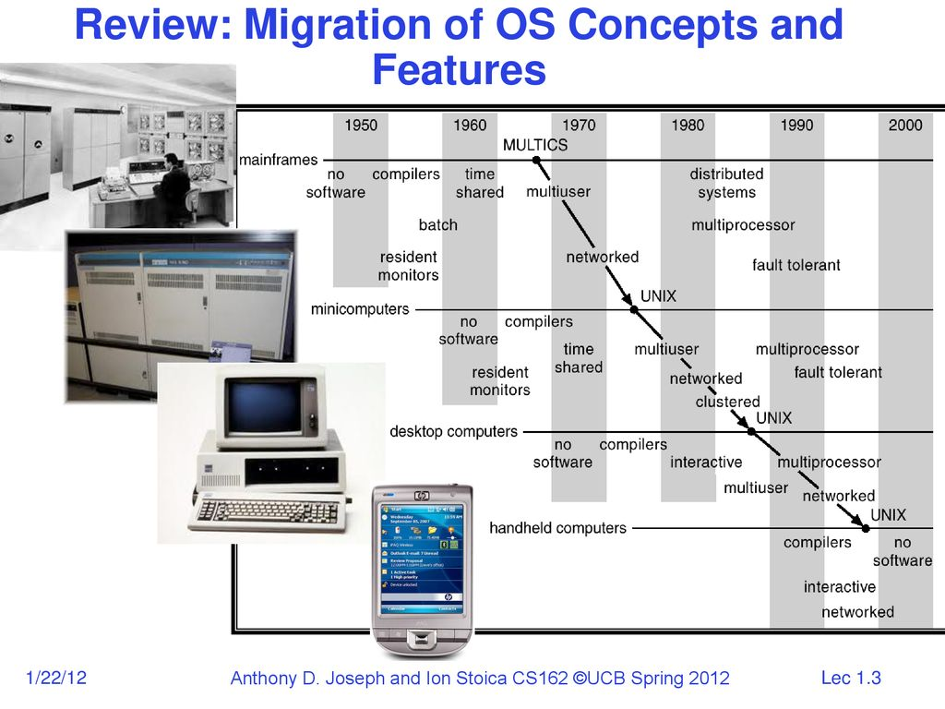
1. Migration of OS Concepts and Features
IGOR SYRYTSIN, CAOS, SW4 2024

Slide 4
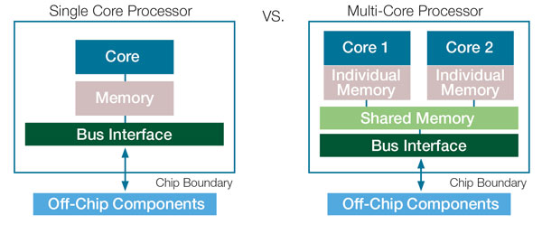
1.1 Single core vs multi-core
Single core processors are designed for linear task processing, whereas multi-core processors handle multiple tasks in parallel.
Multi-core CPUs offer enhanced performance with shared memory for efficient data access.
The bus interface in multi-core setups manages more complex data flows than in single-core systems.
Multi-core processors improve energy efficiency and reduce heat output during multitasking.
Software optimized for multi-core processors can significantly outperform those running on single-core systems.
IGOR SYRYTSIN, CAOS, SW4 2024

Slide 5
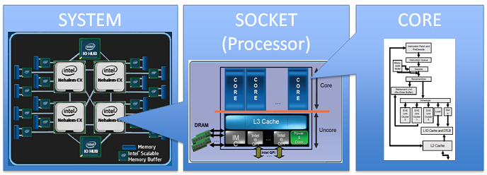
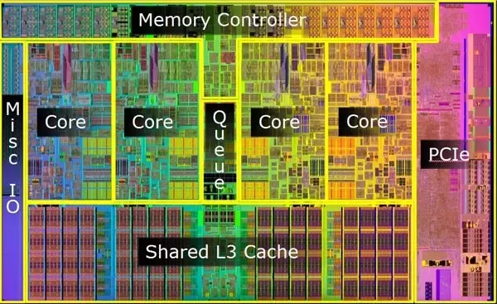
1.2 The complexity of a modern multi-processor, multi-core system
Integrating multiple processing units: Showcasing the interconnectedness of various CPUs within a single system for enhanced computing power.
Hierarchical memory architecture: Highlighting the role of different cache levels in optimizing data retrieval and processing speed.
Core synergy: Describing how cores within a single processor work together to execute complex tasks efficiently.
Resource sharing: Detailing the shared components, like the L3 cache, which can be accessed by all cores to improve task coordination.
Parallel processing capabilities: Discussing the system's ability to perform multiple operations simultaneously, leading to significant performance gains.
Inter-core communication: Explaining the pathways and protocols that enable cores to exchange information and maintain system harmony.

Slide 6
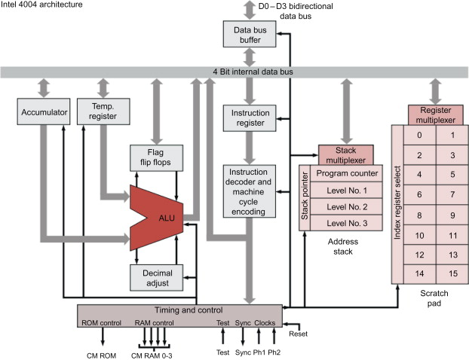
1.3 Functionality of a processor core
Central Processing: The Arithmetic Logic Unit (ALU) executes arithmetic and logical operations, serving as the core's primary computational engine.
Data Handling: A 4-bit internal data bus facilitates the transfer of information within the core, allowing for efficient data management and processing.
Instruction Flow: The instruction register and decoder work in tandem to interpret and execute commands, orchestrating the core's operations.
Program Navigation: The program counter keeps track of instruction sequencing, ensuring the core processes instructions in the correct order.
Temporary Storage: Accumulator and flag flip-flops temporarily hold data and status bits, respectively, aiding in the execution of instructions.
Expanded Operations: Stack management, including a multi-level stack, enables complex instruction sets and subroutine management within the core's architecture.
IGOR SYRYTSIN, CAOS, SW4 2024

Slide 7
1.4 – The problem and solution
The basic problem of concurrency involves resources:
Hardware: single CPU, single DRAM, single I/O devices
Multiprogramming API: users think they have exclusive access to machine
OS Has to coordinate all activity
Multiple users, I/O interrupts, …
How can keep this straight?
Basic Idea: Use Virtual Machine abstraction
Decompose hard problem into simpler ones
Abstract the notion of an executing program
Then, worry about multiplexing these abstract machines
IGOR SYRYTSIN, CAOS, SW4 2024

Slide 8
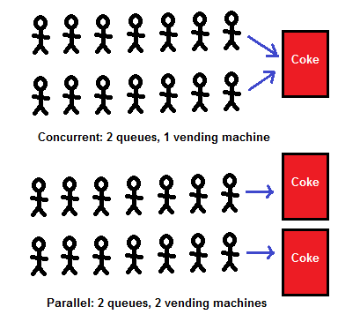
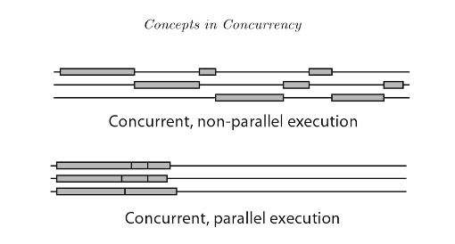
1.5 - Defining concurrency
IGOR SYRYTSIN, CAOS, SW4 2024

Slide 9
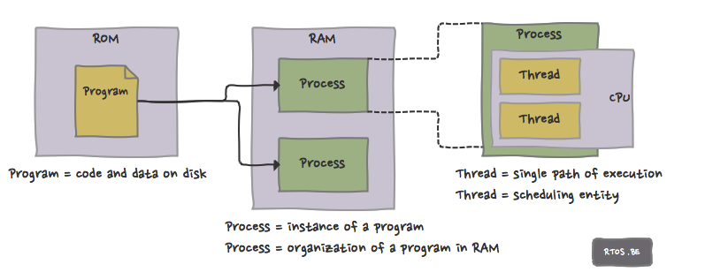
1.6 – Threads and Processes
IGOR SYRYTSIN, CAOS, SW4 2024

Slide 10
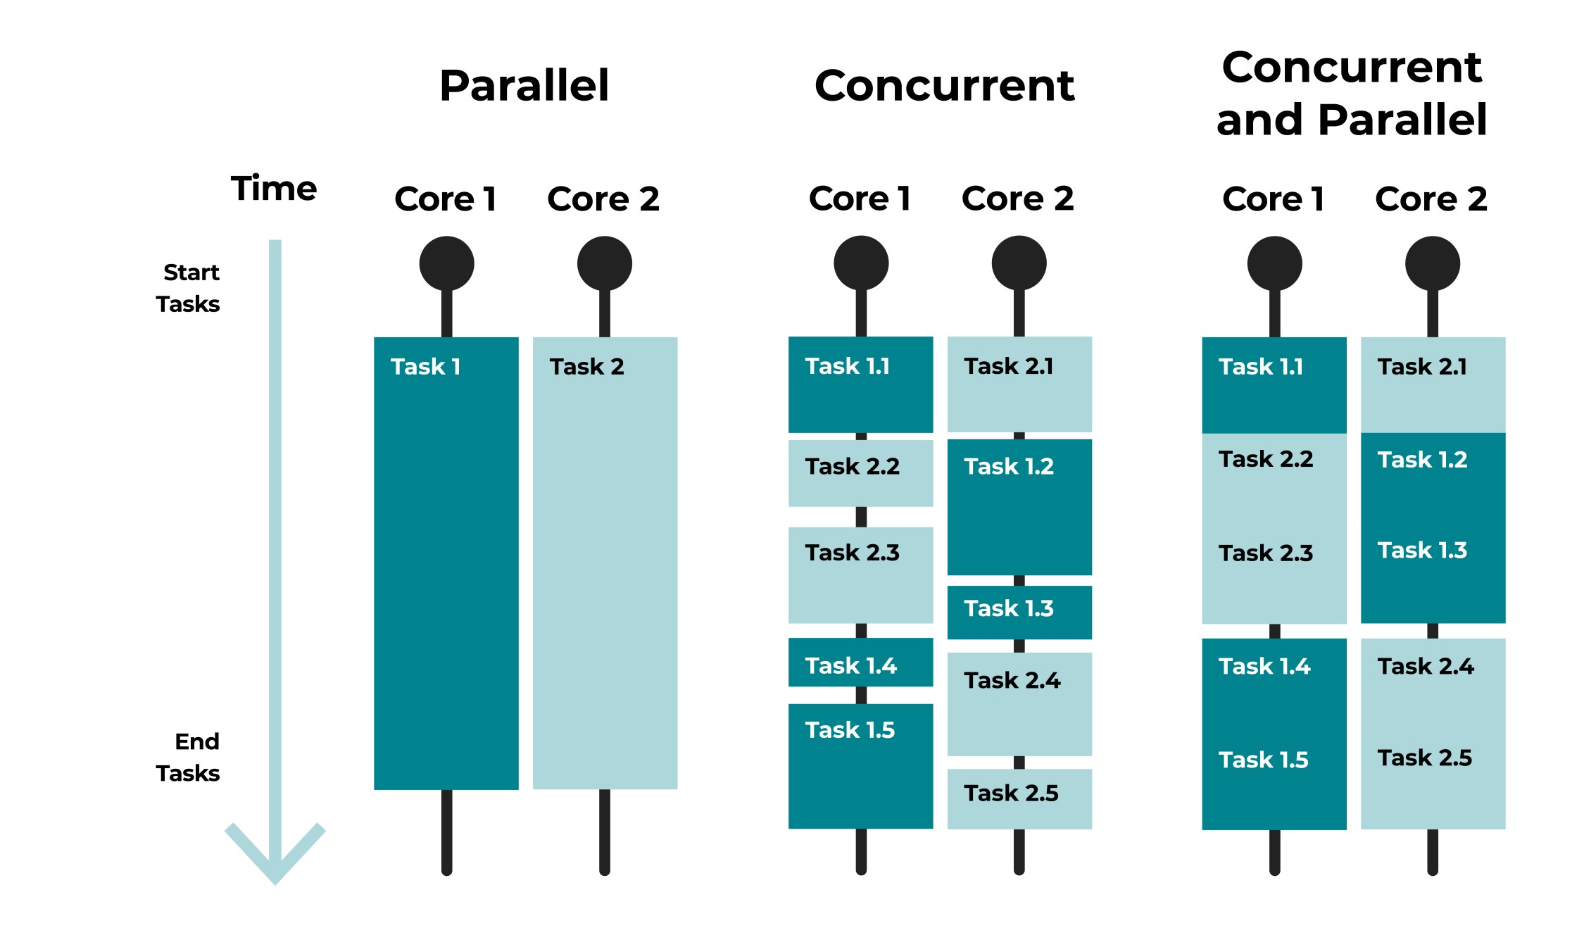
1.7 – Parallel vs concurrent execution
parallel: Using multiple processing resources (CPUs, cores) at once to solve a problem faster.
Example: A sorting algorithm that has several threads each sort part of the array.
concurrent: Multiple execution flows (e.g. threads) accessing a shared resource at the same time.
Example: Many threads trying to make changes to the same data structure (a global list, map, etc.).
IGOR SYRYTSIN, CAOS, SW4 2024

Slide 11
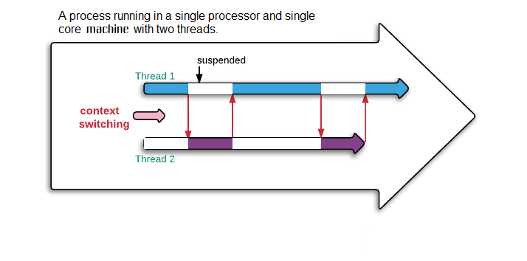
1.8 – Advantages
Unlike parallelism, not always about running faster.
Even a single-CPU, single-core machine may want concurrency.
Useful for:
App responsiveness
Example: Respond to GUI events in one thread while another thread is performing an expensive computation
Processor utilization (mask I/O latency)
If 1 thread is stuck working, others have something else to do
Failure isolation
Convenient structure if want to interleave multiple tasks and do not want an exception in one to stop the other
IGOR SYRYTSIN, CAOS, SW4 2024

Slide 12
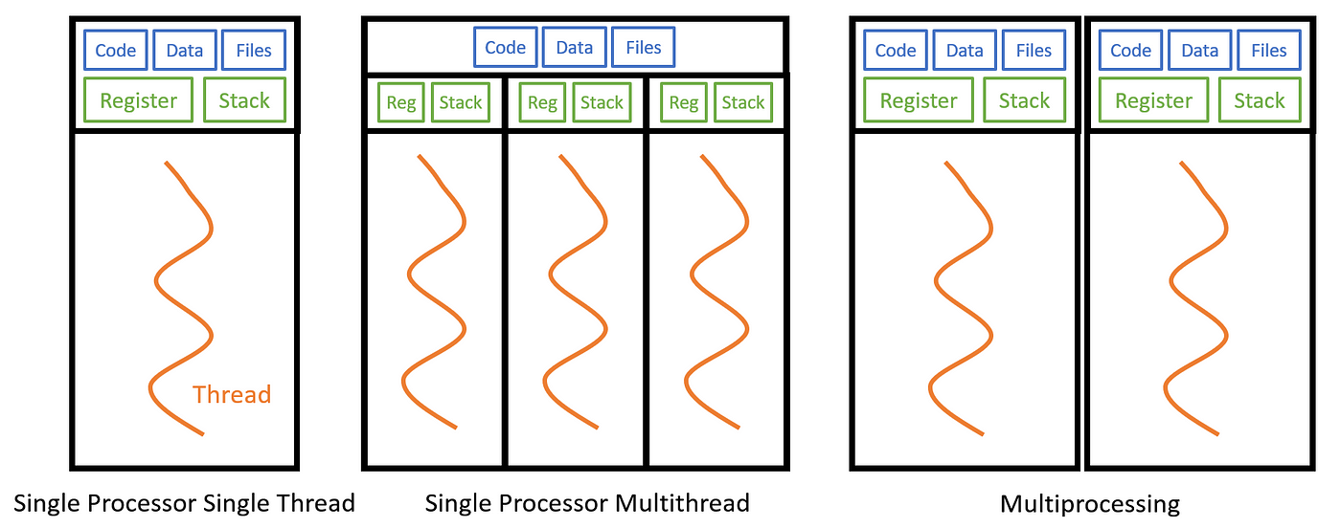
1.9 - Its significance in operating systems
Multitasking involves the execution of multiple tasks by rapidly switching between them. Each task gets a time slot, and the OS switches between them so quickly that it seems as if they are running simultaneously.
Multithreading takes advantage of modern processors with multiple cores. It allows different threads of a process to run on separate cores, enabling true parallelism within a single process.
Multiprocessing goes a step further by distributing multiple processes across multiple physical processors or cores, achieving parallel execution at a higher level.
IGOR SYRYTSIN, CAOS, SW4 2024

Slide 13
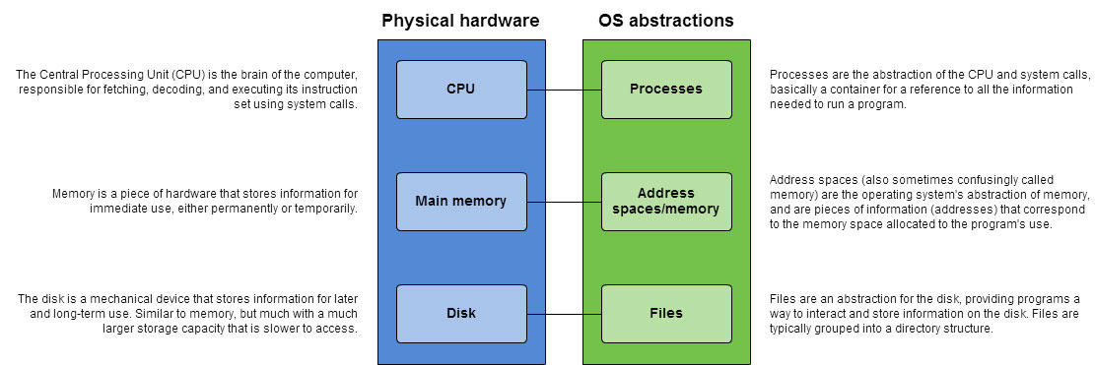
1.10 - Fundamental OS Abstractions
IGOR SYRYTSIN, CAOS, SW4 2024

Slide 14
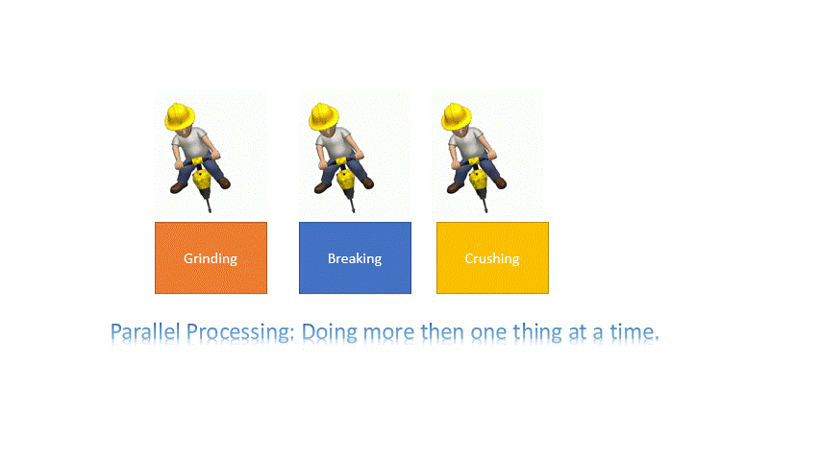
1.11 - Parallelism illusion in operating systems
IGOR SYRYTSIN, CAOS, SW4 2024

Slide 15
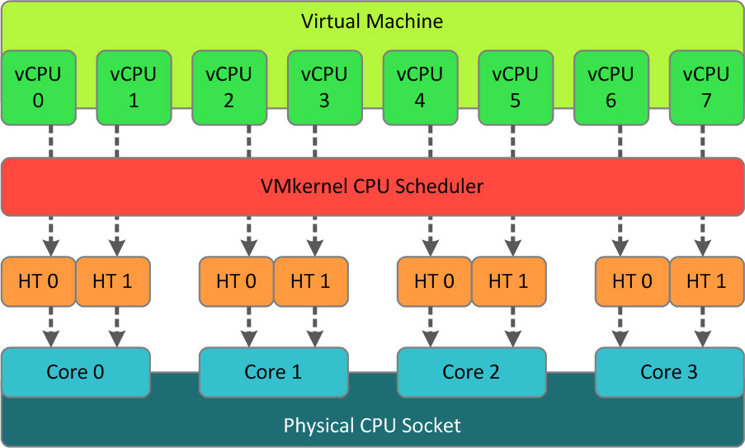
1.12 - Concept of virtual CPUs
Virtual CPUs (vCPUs) allow a single physical CPU core to appear as multiple logical processors.
The VMkernel CPU Scheduler assigns time slots on physical cores to vCPUs, optimizing resource use.
Hyper-Threading technology enables each core to run multiple threads, enhancing performance.
vCPUs contribute to improved multitasking by allowing several operations to occur simultaneously within a virtual machine.
This architecture enhances the efficiency of virtual machines, allowing them to serve multiple applications and services.
IGOR SYRYTSIN, CAOS, SW4 2024

Slide 16
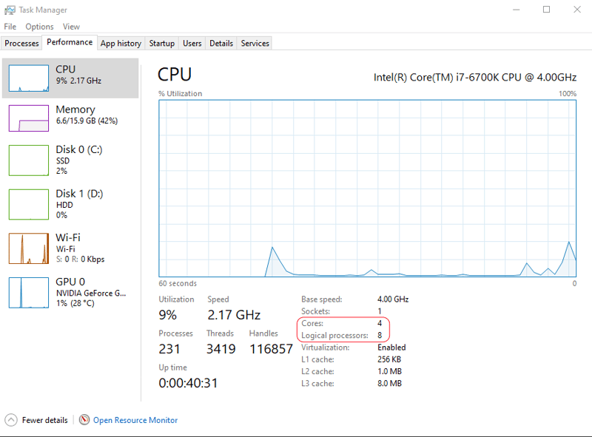
2 - Threads and Processes
For example, I have 8 CPUs and each of them contains 4 cores, so my computer can run 8 processes and 32 threads concurrently. To check how many you have open Task Manager, Performance tab.
IGOR SYRYTSIN, CAOS, SW4 2024

Slide 17
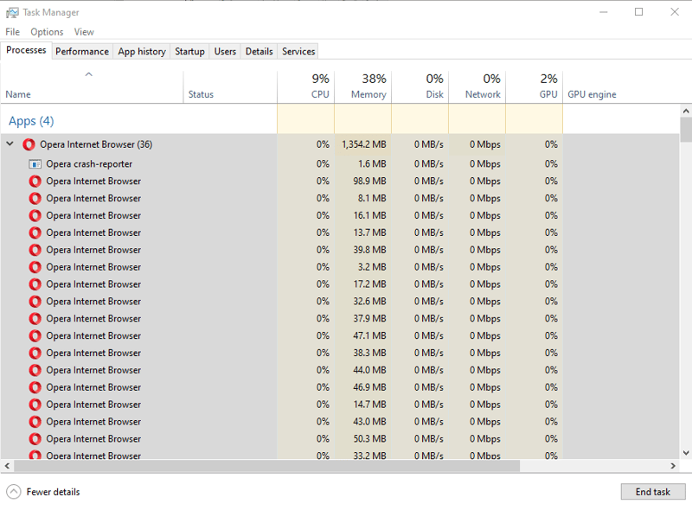
2.1 - Threads and Processes
A single application can spawn multiple processes (35), enhancing stability and performance.
Each browser process consuming a separate portion of system memory.
The operating system's capable to handle numerous tasks simultaneously without compromising on performance.
Modern CPU’s ability to rapidly switch context between tasks, providing the illusion of parallel process execution.
A multi-core CPU in distributing the workload across various cores, ensuring system responsiveness.
Task Manager serves as a powerful tool to monitor and manage resource allocation for active applications and background processes.
Although I have 17 tabs opened in my web browser, the number of processes is 35. How is my system not overloaded?
IGOR SYRYTSIN, CAOS, SW4 2024

Slide 18

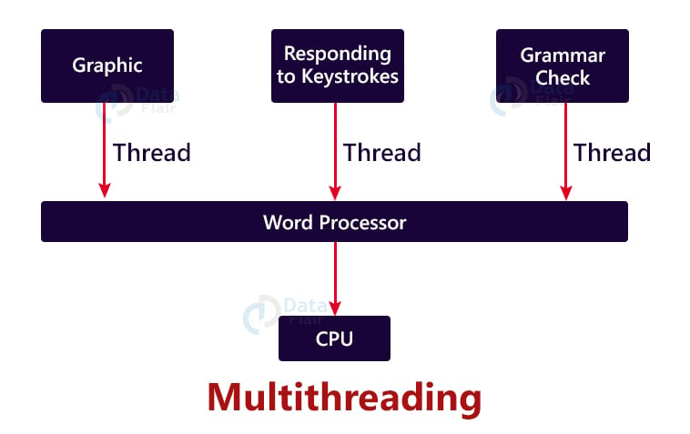
2.2 - Threads as a New Abstraction
Enhanced Responsiveness: Multithreading allows various game elements like audio, graphics, and AI to operate simultaneously, ensuring fluid gameplay.
Parallel Tasks Execution: By abstracting complex tasks into separate threads, games can execute multiple operations concurrently, improving efficiency.
Dynamic Game Environments: Different threads manage environmental changes and character interactions, contributing to a more dynamic and immersive experience.
Improved Resource Utilization: Utilizing multithreading, games can better leverage CPU cores for balanced load distribution.
Scalability and Performance: Multithreading in games allows scalability, supporting a wide range of hardware capabilities while maintaining performance.
Real-time Interaction and Feedback: Separate threads for user input and interface elements allow for real-time player feedback and interaction.
IGOR SYRYTSIN, CAOS, SW4 2024

Slide 19
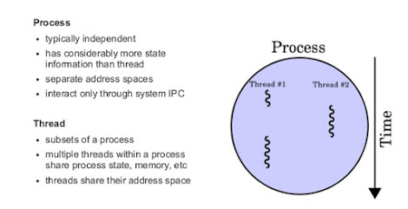
2.3 - Differences between threads and processes
Threads are typically used when the task involves a lot of I/O or synchronization with other threads or processes. For example, a web server that needs to handle multiple requests concurrently can use a thread pool to process each request in a separate thread. This allows the server to handle multiple requests simultaneously and avoid blocking while waiting for I/O operations to complete.
On the other hand, processes are typically used when the task involves a lot of CPU-bound processing or when there are multiple CPUs or cores available to execute the task in parallel. For example, a video encoding application that needs to encode multiple videos concurrently can use multiple processes to encode each video in a separate process. This allows the application to take advantage of the available CPUs or cores and encode multiple videos simultaneously.
Switching between processes is resource-intensive as it involves saving and terminating current tasks before starting new ones. Threads, sharing memory within the same process, can switch more efficiently, making them less demanding than processes.
IGOR SYRYTSIN, CAOS, SW4 2024

Slide 20
2.4 - Multi-threaded program execution points
Execution points in a multi-threaded program refer to the distinct paths of execution that occur simultaneously within a process.
Each thread has its own execution sequence but shares the process's resources like memory and file handles.
Threads can run independently while also interacting through shared data, leading to efficient use of system resources.
The CPU scheduler assigns time slices to each thread, allowing for concurrent execution and improved program responsiveness.
Synchronization mechanisms, such as mutexes and semaphores, ensure threads don't interfere with each other's operation when accessing shared resources.
Debugging multi-threaded programs can be complex due to potential issues like race conditions and deadlocks, which arise from threads' interdependencies.
IGOR SYRYTSIN, CAOS, SW4 2024

Slide 21
2.5 - Multi-threaded program execution points
If a given piece of code is run by two threads at once:
The order of which thread gets to run first is unpredictable.
How many statements of one thread run before the other thread runs some of its own statements is unpredictable.
// Thread 1 // Thread 2
public void foo() { public void foo() {
... statement1;
statement1; ...
statement2; ...
... statement2;
statement3; ...
} statement3;
}
IGOR SYRYTSIN, CAOS, SW4 2024

Slide 22
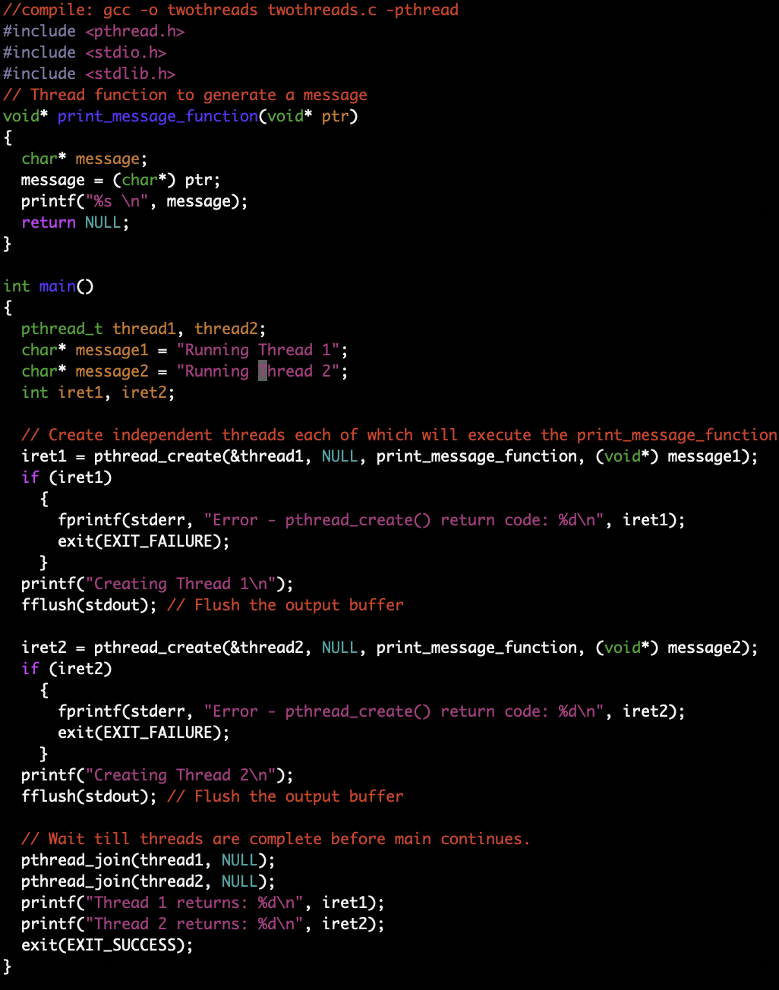
2.6 - Multi-threaded program execution points
Includes and Function Definition:
The program begins by including necessary headers: <pthread.h> for threads, <stdio.h> for input/output, and <stdlib.h> for general purpose standard library.
A thread function print_message_function is defined, which takes a void* pointer as an argument, casts it to a char* (string), and prints it.
Main Function:
Two thread identifiers, thread1 and thread2, are declared.
Two string messages are defined that will be passed to the threads.
Two integers, iret1 and iret2, are declared to capture the return value of the thread creation process.
Creating Threads:
pthread_create is called twice to create two threads. It takes four arguments:
A pointer to pthread_t which uniquely identifies the thread.
An attribute object that can be used to set thread attributes (NULL is passed, which means the thread is created with default attributes).
The function to run on the thread. In this case, print_message_function.
An argument to pass to the thread function, message1 for thread1 and message2 for thread2.
If pthread_create returns a non-zero value, an error has occurred, and the program prints an error message and exits.
Thread Execution:
Once the threads are created successfully, they begin execution. In this program, threads run the print_message_function and print the message passed to them.
Waiting for Threads:
pthread_join is used to wait for the threads to finish their execution. This function blocks the calling thread (main thread) until the specified thread1 and thread2 terminate.
After the threads are joined, the main function prints the return values of pthread_create for both threads, which would be 0 in the case of successful thread creation.
Program Exit:
Finally, the main function exits successfully.
IGOR SYRYTSIN, CAOS, SW4 2024

Slide 23
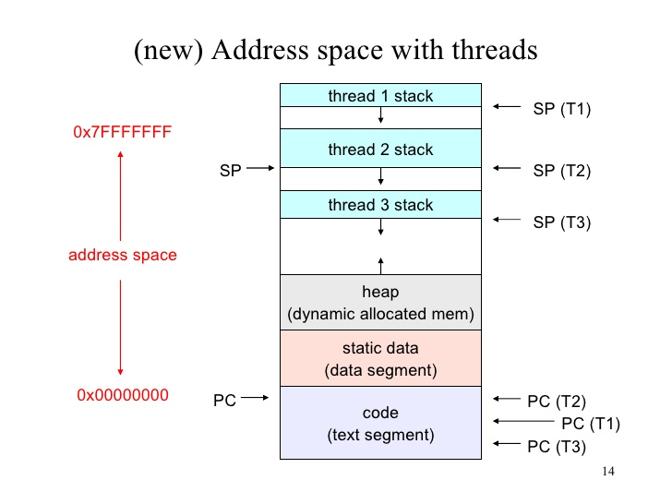
2.7 - Shared address space among threads
Individual stacks for each thread (thread 1 stack, thread 2 stack, thread 3 stack) allow separate execution contexts.
All threads share the same heap space, enabling dynamic memory allocation that can be accessed by any thread.
A common code segment (text segment) is shared by all threads, ensuring they execute the same set of instructions.
Static data (data segment) is also shared, allowing threads to access and modify global variables.
Each thread has its own stack pointer (SP) and program counter (PC), which points to the current instruction to execute and the current stack frame.
IGOR SYRYTSIN, CAOS, SW4 2024

Slide 24
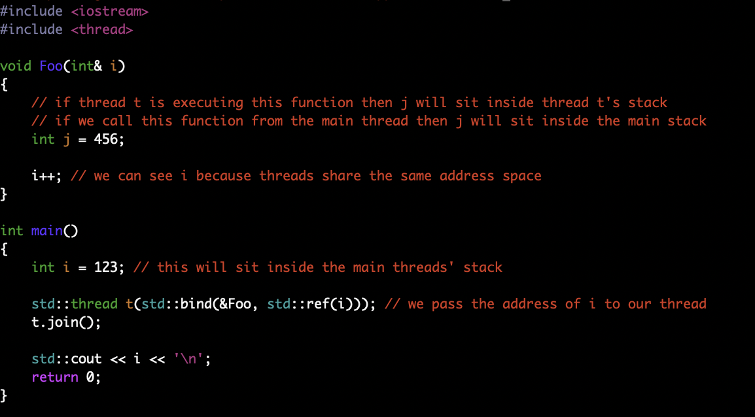
2.8 - Shared address space among threads
Purpose of the Program:
Demonstrates the use of threads in C++ to modify shared data.
Shows how to pass references to a thread function, allowing threads to share and modify the same memory location.
Functionality Explained:
Function Definition (Foo):
Accepts an integer reference (int& i) to demonstrate data sharing between threads.
Contains a local variable j set to 456, which is only relevant within the scope of Foo.
Increments the passed reference i, which alters the original variable in the caller's scope (main).
Main Function:
Declares an integer i initialized to 123, intended to be modified by a thread.
Creates a thread t using std::thread that targets the Foo function with i as an argument passed by reference.
Uses std::bind and std::ref to correctly pass i as a reference to the thread function.
Calls t.join() to ensure the main thread waits for t to complete before continuing, ensuring i is correctly modified before it's printed.
Outputs the modified value of i (which will be 124), demonstrating the thread's impact on the shared variable.
IGOR SYRYTSIN, CAOS, SW4 2024

Slide 25
2.9 - Context switching nuances
Context switching involves saving the state of a currently running thread and restoring the state of the next scheduled thread.
Switching context for threads within the same process is faster than between processes due to shared memory.
The CPU saves the state of the current thread to its Thread Control Block (TCB), including program counter and registers.
The overhead of context switching is critical for performance, especially in systems with many threads.
Modern CPUs use techniques like cache memory to optimize the time taken for context switching.
The operating system scheduler determines when and which thread's context is to be switched based on the scheduling algorithm used.
IGOR SYRYTSIN, CAOS, SW4 2024

Slide 26
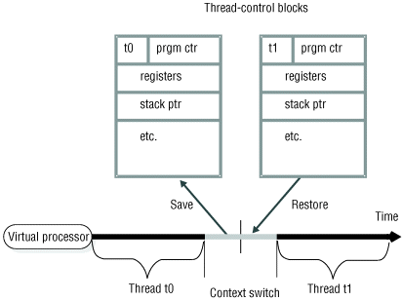
2.10 - Thread State and Context Switching
Thread state consists of all the information needed to resume a thread's execution, which includes program counter, registers, and stack pointer.
During a context switch, the state of the current thread (Thread t0) is saved into its Thread-Control Block (TCB) to allow the thread to be resumed later.
The virtual processor then restores the state of the next thread (Thread t1) from its TCB, effectively switching execution to that thread.
The switch occurs over time, as illustrated by the timeline, with the system alternating between saving and restoring states for various threads.
Efficient context switching is vital for the responsiveness and multitasking ability of an operating system.
IGOR SYRYTSIN, CAOS, SW4 2024

Slide 27
2.11 - Components of thread state
Program Counter (PC): Holds the address of the next instruction to be executed by the thread.
Registers: Set of registers, including general-purpose registers, floating-point registers, and status registers, holding the current working variables and other execution context details.
Stack Pointer (SP): Points to the top of the thread's stack in memory, which contains function parameters, return addresses, and local variables.
Thread-local Storage (TLS): Storage area for variables that are unique to the thread.
Instruction Register: Contains the currently executing instruction.
Program Status Word (PSW): Contains status information, such as the condition codes and the enabling or disabling of interrupts.
CPU Scheduling Information: Priority and other scheduling-related data that the operating system scheduler uses to manage execution.
I/O Status Information: Details about any I/O operations, such as file descriptors or I/O requests, the thread may have pending.
Accounting Information: May include usage counters like CPU time consumed, which is used for system monitoring and accounting purposes.
IGOR SYRYTSIN, CAOS, SW4 2024

Slide 28
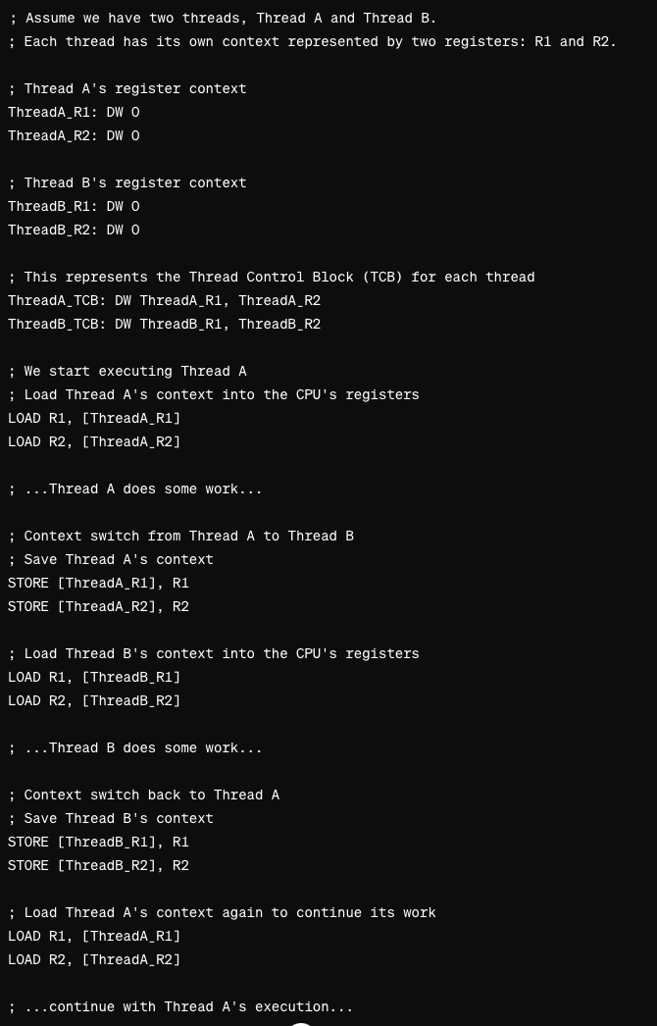
2.12 – Pseudo-Assembly example
In this example
DW directive defines a word-sized variable
LOAD mimics an instruction that loads a value from memory into a register
STORE mimics an instruction that stores a value from a register to memory.
The R1 and R2 registers are just examples; in a real CPU, the register names would be specific to the CPU architecture (like EAX, EBX for x86)
IGOR SYRYTSIN, CAOS, SW4 2024

Slide 29
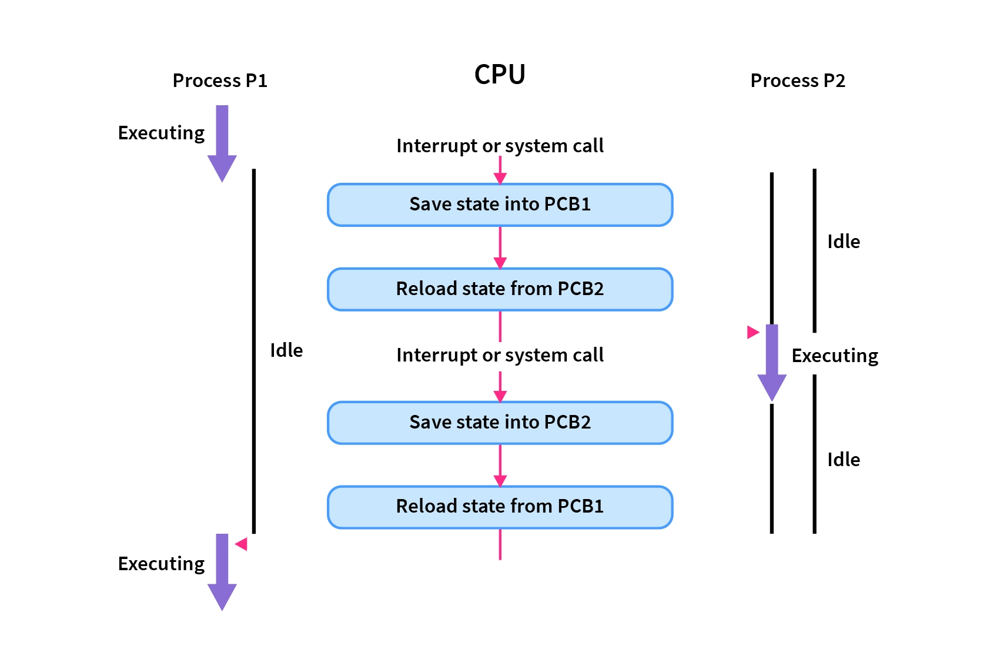
2.13 - Process vs. thread context switching
Process P1 and P2 Execution: The diagram illustrates two processes, P1 and P2. Initially, P1 is executing while P2 is idle.
CPU Interruption: An interrupt or system call causes the CPU to stop executing the current process.
Save State into PCB1: The CPU saves the current state of P1 into its Process Control Block (PCB1) before switching.
Reload State from PCB2: To switch to P2, the CPU loads the state from P2's PCB (PCB2) and begins executing P2.
P2 Becomes Active: With the state of P2 loaded, P2 is now executing while P1 becomes idle.
Subsequent Switches: The process repeats as further interrupts or system calls occur, with the CPU saving and reloading states between PCB1 and PCB2 as it alternates between processes.
IGOR SYRYTSIN, CAOS, SW4 2024

Slide 30
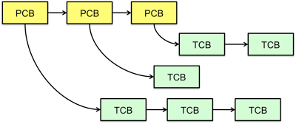
2.14 - Thread Control Blocks (TCBs)
IGOR SYRYTSIN, CAOS, SW4 2024

Slide 31
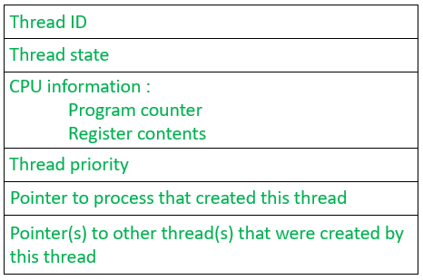
2.15 - Introduction to TCBs
Thread ID: A unique identifier for the thread.
Thread State: The current status of the thread (e.g., running, ready, blocked).
CPU Information:
Program Counter: Indicates the next instruction to execute.
Register Contents: The current values of the CPU registers for this thread.
Thread Priority: A value indicating the thread's importance relative to other threads, determining its scheduling.
Pointer to Process: A reference to the process that created the thread, linking it to its parent process.
Pointer(s) to Other Threads: References to any other threads created by this thread, establishing a hierarchy or network of threads within the same process.
IGOR SYRYTSIN, CAOS, SW4 2024

Slide 32
2.16 - Their role in storing thread state
Preserving Execution Context: TCBs hold all the necessary information to preserve the execution context of a thread. When a context switch occurs, the CPU state associated with the thread is saved into its TCB, allowing the thread to resume execution later without loss of information.
Enabling Thread Scheduling: The operating system's scheduler uses the information in the TCB, like thread state and priority, to make decisions about which thread to run next.
Synchronizing Threads: Information in the TCB can be used to manage synchronization between threads, ensuring that resources are shared and accessed correctly.
Tracking Thread Resources: TCBs contain pointers to the resources that threads can access, which include memory locations, files, and other threads.
Facilitating Communication: By storing pointers to other related threads, TCBs facilitate inter-thread communication and coordination.
Error Handling: The TCB may store information about the thread's health, which ca
IGOR SYRYTSIN, CAOS, SW4 2024

Slide 33
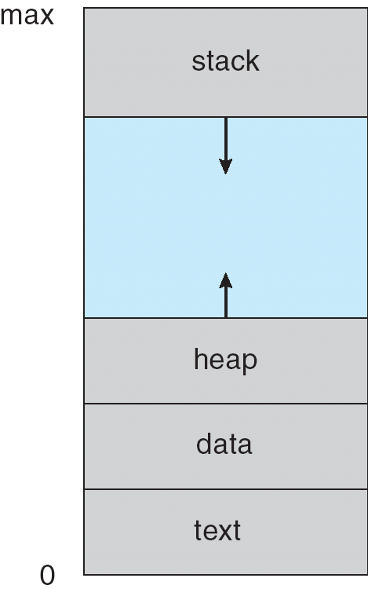
2.17 - Program Address Space
Stack:
A region of memory that stores temporary variables created by each function (including the main() function).
It operates on a Last-In-First-Out (LIFO) principle, meaning that data most recently added will be the first to be removed.
Typically used for variables local to a function, function parameters, return addresses, and for handling function calls and returns.
Data (Data Segment):
This memory segment contains the global and static variables that are initialized by the programmer.
Unlike the stack, the data segment is not managed by the LIFO principle, and the size is determined at compile-time.
It is divided into initialized data and uninitialized data (often called the BSS segment).
Text (Text Segment or Code Segment):
The text segment is a portion of memory that contains the executable instructions of a program.
It is read-only to prevent a program from accidentally modifying its instructions.
Also known as the code segment.
Heap:
The heap is a region of memory used for dynamic memory allocation where blocks of memory are allocated and freed in an arbitrary order.
The size of the heap adjusts dynamically as the program runs and is not managed automatically by the LIFO principle.
It is managed through library functions like malloc(), calloc(), free() in C, and new, delete in C++ or automatic memory management like garbage collection in Java.
Program Address Space
IGOR SYRYTSIN, CAOS, SW4 2024

Slide 34
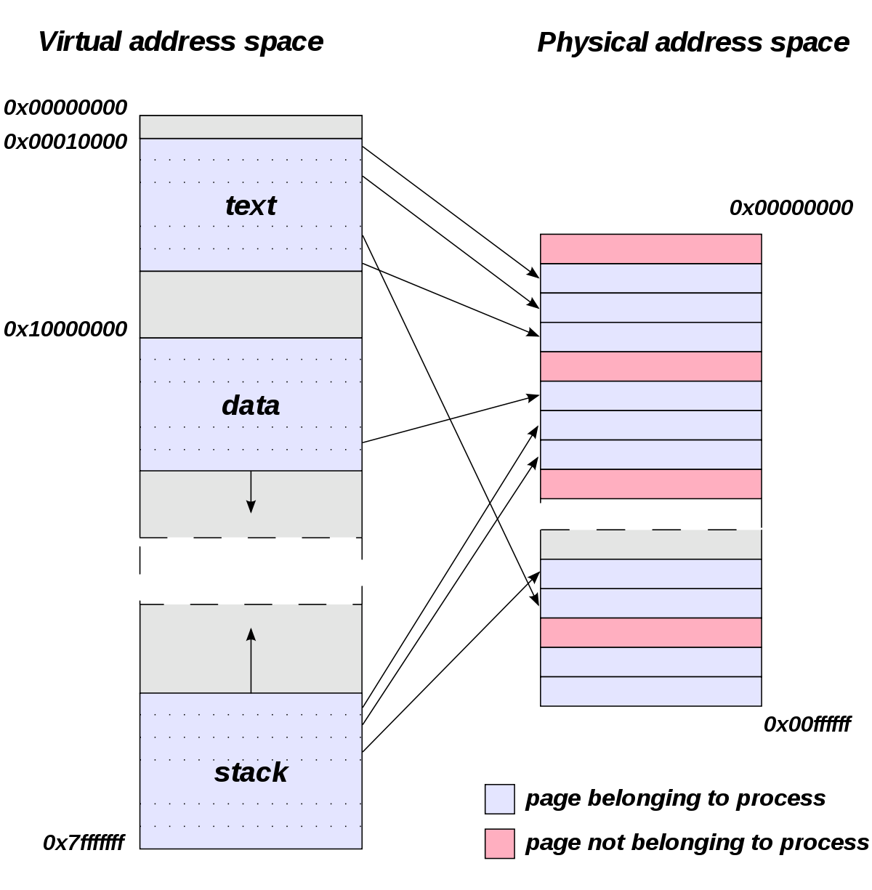
2.18 - Process Address Space
IGOR SYRYTSIN, CAOS, SW4 2024

Slide 35
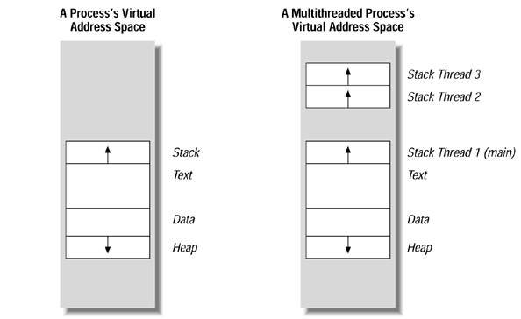
2.19 - Address space differences in multi-threaded processes
Single-Threaded Process:
Has one contiguous stack space.
Includes a text segment for the executable code.
Contains a data segment for global and static variables.
Features a heap for dynamic memory allocation.
Multi-Threaded Process:
Each thread has its own stack within the same address space, allowing for separate execution contexts (like different function calls, variables, etc.).
Shares the text, data, and heap segments among all threads.
Enables threads to execute different parts of the program simultaneously or to perform
IGOR SYRYTSIN, CAOS, SW4 2024

Slide 36
3 - Concurrency Challenges
Race Conditions: Occur when multiple threads access shared data and try to change it concurrently, leading to inconsistent or unexpected outcomes.
Deadlocks: Happen when two or more threads are waiting for each other to release resources, creating a standstill where none of the threads can proceed.
Starvation: When one or more threads are perpetually denied necessary resources, leading to a situation where they can't make progress.
Thread Interference: Mistakes in synchronization logic can cause threads to step over each other, resulting in corrupted shared states.
Context Switch Overhead: Frequent switching between threads can lead to performance issues due to the overhead associated with saving and loading thread states.
Priority Inversion: A lower-priority thread holds a lock needed by a higher-priority thread, causing the higher-priority thread to be indirectly pre-empted.
IGOR SYRYTSIN, CAOS, SW4 2024

Slide 37
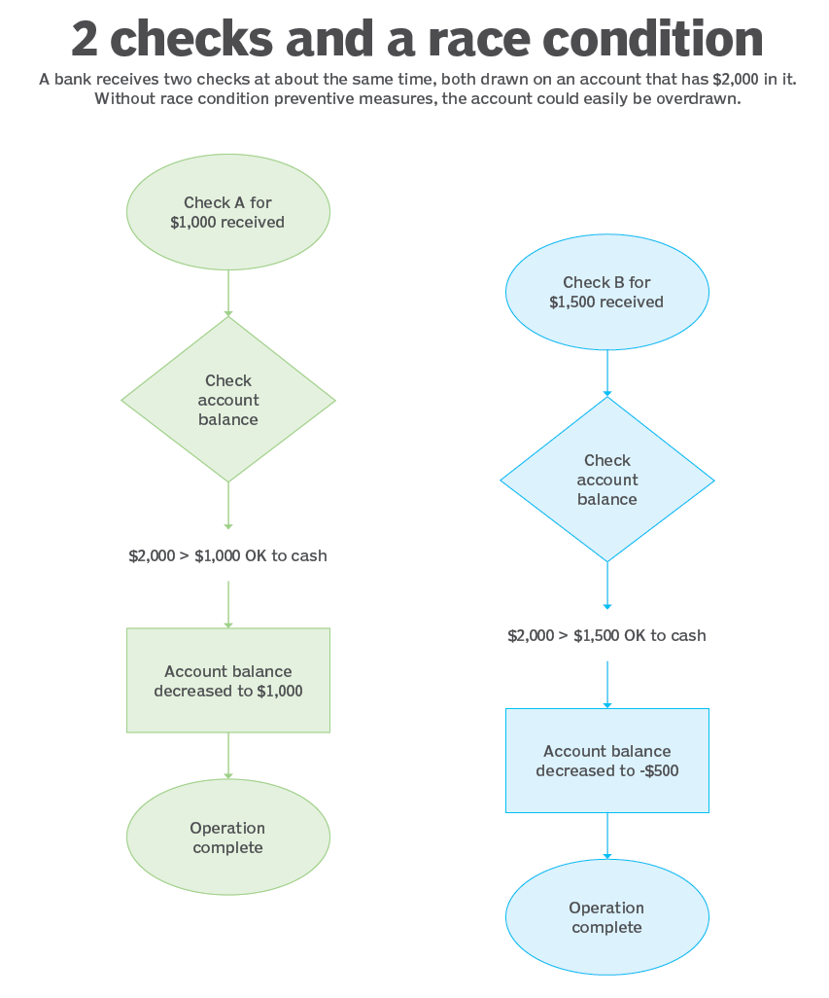
3.1 - Shared Data and Race Conditions
Concurrent Transactions: Both Check A and Check B are processed nearly simultaneously without proper synchronization.
Insufficient Balance Check: Each transaction checks if the account balance covers the check amount, which it does at the moment of checking.
Overdraft Risk: Without preventive measures, the account is prone to being overdrawn, as the balance is not updated in real-time for concurrent checks.
Erroneous Account Update: The account balance is reduced based on each check independently, potentially leading to a negative balance.
Need for Synchronization: Proper locking mechanisms are required to prevent one thread from reading or writing the shared balance while it's being updated by another.
Transaction Atomicity: Ensuring that the check balance and deduction process is atomic would prevent one transaction from interfering with another.

Slide 38
3.2 – How to check race conditions
Code Review: Carefully review code for critical sections where shared resources are accessed. Look for variables that are read and written by multiple threads.
Testing with High Concurrency: Execute your application with the maximum number of concurrent threads to increase the chance of encountering race conditions.
Instrumentation: Use tools to instrument the code to log detailed information about thread operations and timings to detect interleavings that cause incorrect behavior.
Stress Testing: Stress test the application under loads that are higher than usual to uncover race conditions that do not appear under normal load.
Static Analysis Tools: Utilize static analysis tools that can analyze the codebase for potential race conditions without running the code.
Dynamic Analysis Tools: Implement dynamic analysis tools that check for race conditions during runtime by monitoring the application's execution.
IGOR SYRYTSIN, CAOS, SW4 2024

Slide 39
3.3 - How to prevent race conditions
Mutexes/Locks: Use mutexes or locks to ensure that only one thread can access the resource at a time.
Atomic Operations: Employ atomic operations provided by the language or libraries that ensure a variable is updated in a single, indivisible operation.
Reentrant Locks: Use reentrant locks which allow threads to acquire the same lock multiple times safely.
Semaphore: A semaphore can control access to a common resource by multiple threads in a concurrent system.
Read-Write Locks: Implement read-write locks when many threads need to read from a shared resource, but only one should write at any given time.
Thread-Safe Data Structures: Utilize or create thread-safe data structures that internally manage synchronization.
Avoid Sharing: Design the program to minimize the sharing of resources between threads or processes.
Immutable Objects: Use immutable objects which can't be changed once created, thereby preventing modification race conditions.
Ordering Access: Establish and maintain a strict order in which locks are acquired to avoid deadlocks, which are often related to race conditions.
Condition Variables: Use condition variables along with locks to allow threads to wait for certain conditions to be true before acquiring a lock.
Transactional Memory: In some systems, you can use software or hardware transactional memory that allows sections of code to execute with transaction-like properties.
IGOR SYRYTSIN, CAOS, SW4 2024

Slide 40
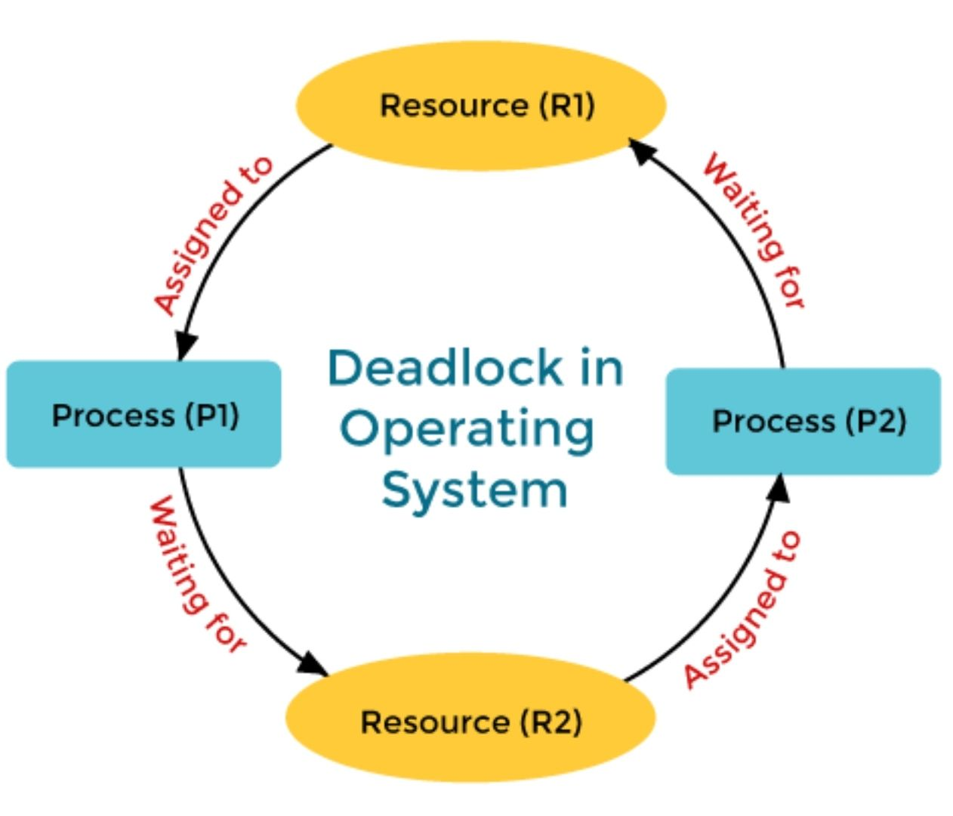
3.4 - Deadlocks
Process P1 has control over Resource R2 and is waiting to acquire Resource R1.
Process P2 holds Resource R1 and is waiting to obtain Resource R2.
This creates a cycle of dependencies where neither process can proceed, and without external intervention, they will wait indefinitely. Preventing, avoiding, or resolving deadlocks is a critical aspect of operating system design and concurrent programming.
IGOR SYRYTSIN, CAOS, SW4 2024

Slide 41
3.5 - Deadlocks
Deadlock Characteristics:
Mutual Exclusion: Exclusive control of resources by processes.
Hold and Wait: Processes holding resources while waiting for others.
No Preemption: Resources cannot be forcibly removed from processes.
Circular Wait: A closed chain of processes exists, each waiting for a resource held by the next process in the chain.
Deadlock Management Strategies:
Prevention: Altering system conditions to make deadlocks impossible.
Avoidance: Dynamically examining resource-allocation state to prevent deadlock.
Detection: Allowing deadlocks to occur, detecting them, and taking actions.
Recovery: After detecting a deadlock, recovering from it, usually by terminating or rolling back some of the processes.
IGOR SYRYTSIN, CAOS, SW4 2024

Slide 42
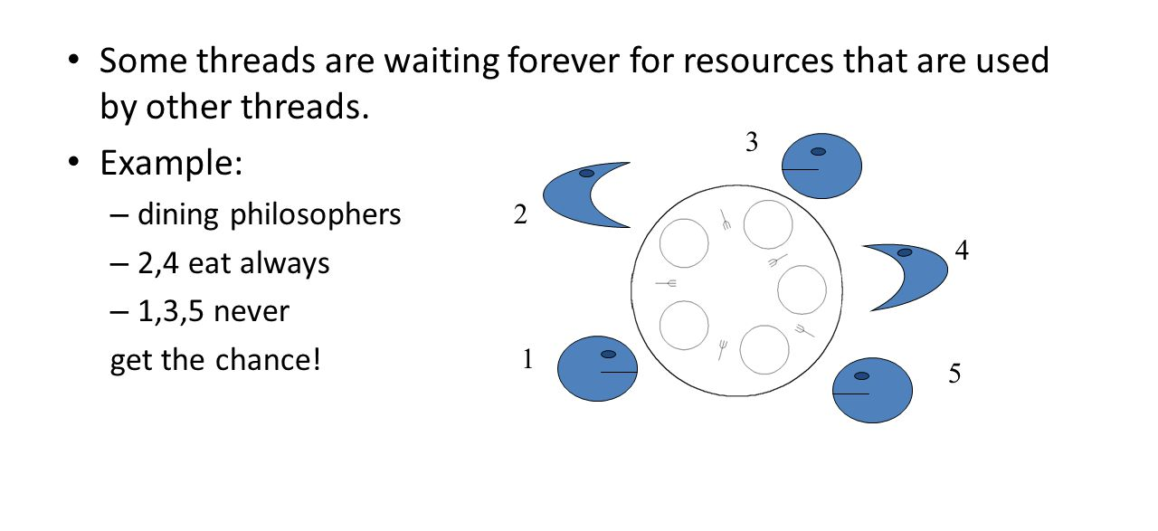
3.6 - Starvation
IGOR SYRYTSIN, CAOS, SW4 2024

Slide 43
3.7 - Starvation
Characteristics of Starvation:
Resource Hogging: One or more processes continuously hold resources others need, leading to indefinite waiting times for certain processes.
Lack of Fairness: The resource scheduling mechanism is biased, favoring certain processes over others.
Indefinite Blocking: A process never leaves the queue for a resource because other processes are constantly jumping ahead of it.
Priority Inversion: Lower-priority processes holding resources needed by higher-priority ones prevent the system from executing in a priority-based manner.
Strategies to Prevent Starvation:
Aging: Gradually increase the priority of waiting processes over time, ensuring they eventually receive the necessary resources.
Fair Queuing: Implement queues that ensure all processes are given a fair chance to access resources in a first-come-first-serve manner or by round-robin scheduling.
Resource Allocation Policies: Design policies to ensure reasonable resource allocation, avoiding indefinite monopolization by any single process.
Priority Donation: Allow a lower-priority process holding a resource needed by a higher-priority process to temporarily inherit the higher priority.
Lock Breaking: Introduce timeouts for resource allocation so that no process can hold a resource indefinitely.
Avoiding Indefinite Postponement: Use scheduling algorithms that avoid conditions leading to starvation, such as guaranteeing each process a time slot for resource access.
IGOR SYRYTSIN, CAOS, SW4 2024

Slide 44
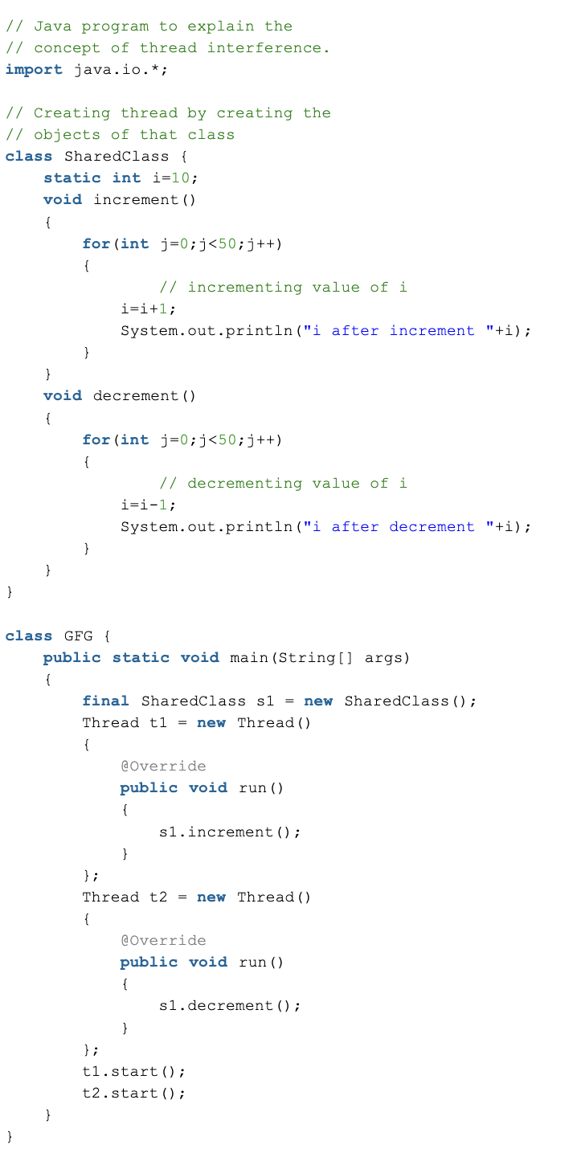
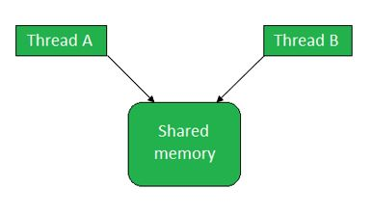
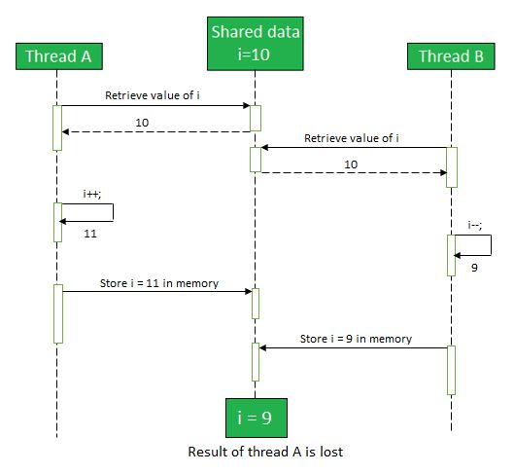
3.8 – Thread interference
Retrieve the value of i from the memory
Increment/Decrement the value of i by 1
Store the new incremented/decremented value of i back to the memory
IGOR SYRYTSIN, CAOS, SW4 2024

Slide 45
3.9 – Thread interference
Characteristics of Thread Interference:
Inconsistent Results: The outcome of operations becomes unpredictable due to concurrent modifications of shared data.
Data Corruption: Simultaneous updates by threads can corrupt the data if one thread reads while another is in the midst of writing.
Order of Execution Issues: The final state depends on the sequence in which the threads run, which is typically non-deterministic.
Difficult Debugging: Issues that arise from thread interference are often hard to replicate and troubleshoot because they may not occur every time the code is executed.
Strategies to Prevent Thread Interference:
Mutexes/Locks: Use mutual exclusion mechanisms to ensure that only one thread can access the resource at a time.
Synchronized Blocks: In languages like Java, use synchronized blocks or methods to restrict multiple threads from executing the critical section at the same time.
Atomic Operations: Use atomic operations provided by the programming language or library that are executed in a single step, making them indivisible.
Reentrant Locks: These allow a lock to be held by the same thread multiple times, preventing external thread interference.
Read-Write Locks: These locks allow multiple readers but only one writer, reducing contention when reads are more frequent than writes.
Immutable Objects: Design objects that don’t change after they’ve been created; immutable objects are inherently thread-safe.
Thread-Local Storage: Use thread-local variables that are not shared between threads, eliminating the risk of interference.
Higher-level Concurrency Controls: Utilize concurrent collections and synchronization frameworks that handle the complexity of thread synchronization for you.
IGOR SYRYTSIN, CAOS, SW4 2024

Slide 46
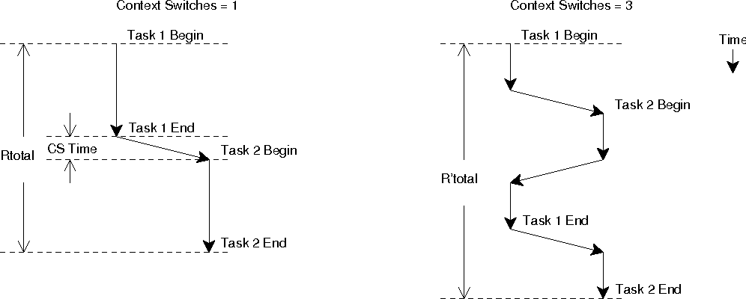
3.10 – context switch overhead
Task 1 begins execution and completes without interruption.
After Task 1 ends, a context switch occurs, marked as "CS Time."
Task 2 then begins and completes.
The timeline shows one instance of overhead for switching from Task 1 to Task 2.
Task 1 begins but is interrupted before completion, leading to a context switch to Task 2.
Task 2 starts but then switches back to Task 1, which then completes.
Another switch returns to Task 2, which then finishes.
There are three context

Slide 47
3.11 - context switch overhead
Characteristics of context switch overhead:
Increased Latency: Context switches add delay as the CPU pauses execution of the current task, saves its state, and then loads the state of the next task.
CPU Time Consumption: Context switches require CPU cycles to execute, temporarily taking processing time away from actual task execution.
Cache Inefficiency: Frequent context switches can lead to cache thrashing where the cache is repeatedly loaded with data from different processes, reducing cache hit rates.
Resource Intensiveness: The operations of saving and restoring state, particularly for complex processes, can consume significant system resources.
Throughput Reduction: High rates of context switching can reduce overall system throughput due to the CPU spending more time switching than executing tasks.
Prevention and mitigation strategies:
Thread Prioritization: Assign priorities to threads to minimize context switching between high and low priority threads unnecessarily.
Thread Affinity: Bind threads to specific CPUs or cores to minimize cache invalidation and maximize cache usage.
Concurrency Control: Implement concurrency mechanisms like semaphores, mutexes, and locks to manage access to shared resources and minimize unnecessary context switching.
Optimize Scheduling Algorithms: Use advanced CPU scheduling algorithms that reduce context switching by grouping similar processes or extending process execution times.
Efficient I/O Management: Design systems to handle I/O operations efficiently, possibly using asynchronous I/O to avoid blocking threads.
Balance Load: Ensure an even distribution of tasks across CPUs and cores to prevent some from being idle while others are overburdened with context switching.
Reduce Overheads: Optimize system code, such as kernel routines, to make context switches as lightweight as possible.
IGOR SYRYTSIN, CAOS, SW4 2024

Slide 48
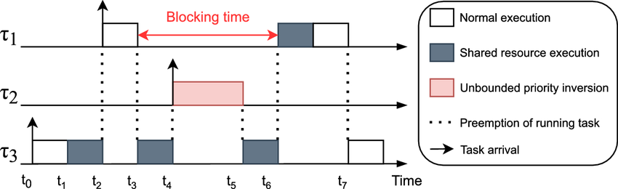
3.12 Priority inversion
Lower-priority task holds a resource needed by a higher-priority task.
Higher-priority task is blocked, unable to proceed until the resource is released.
Medium-priority tasks preempt the lower-priority task, extending the blocking time.
System efficiency is reduced, potentially leading to missed deadlines.
Can lead to system instability if critical tasks are blocked for too long.
Prevention of Priority Inversion:
Priority Inheritance Protocol: Lower-priority tasks inherit the priority of the higher-priority task they are blocking.
Priority Ceiling Protocol: Set a maximum priority level that a task can have when it locks a resource.
Lock-Free Algorithms: Design algorithms that avoid locking shared resources whenever possible.
Preemptive Scheduling: Use a scheduling system that can interrupt a lower-priority task in favor of a higher one when necessary.
Resource Access Management: Carefully manage the access to shared resources with robust synchronization primitives.
Timed Locks: Limit the time a task can hold a resource to minimize the impact on higher-priority tasks.
IGOR SYRYTSIN, CAOS, SW4 2024

Slide 49
4 - Practical Applications of Concurrency
Web Servers: Handling multiple user requests simultaneously to serve web pages efficiently.
Database Systems: Allowing concurrent access to databases for reading and writing operations, enhancing performance and user experience.
Real-Time Systems: In systems like air traffic control or patient monitoring, tasks need to be executed concurrently to respond to real-time events.
Operating Systems: Running multiple applications and services at once, managing resources like CPU, memory, and I/O effectively.
Multimedia Applications: Streaming audio and video where different streams are processed in parallel to synchronize playback.
Financial Trading Systems: Processing numerous trades and transactions concurrently to ensure market stability and timely updates.
Telecommunications: Managing multiple calls and data sessions in a network, ensuring seamless communication among thousands of users.
Parallel Computing: Utilizing multi-core processors to perform complex computations for scientific research, image processing, and data analysis concurrently.
IGOR SYRYTSIN, CAOS, SW4 2024

Slide 50
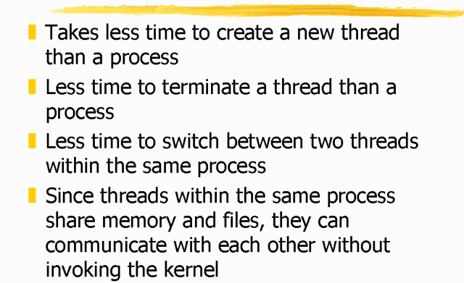
4.1 - Advantages of Threads
IGOR SYRYTSIN, CAOS, SW4 2024

Slide 51
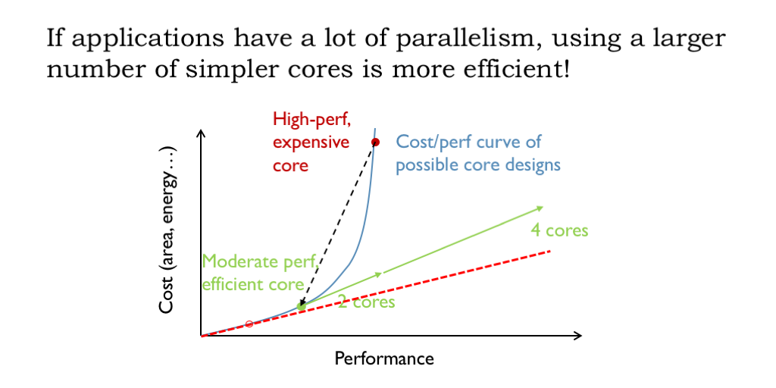
4.2 - Enhancing parallelism and performance
Performance Needs: For applications that benefit from parallel processing (like video rendering or scientific simulations), more cores can significantly improve performance.
Software Compatibility: Some software can't take advantage of multiple cores, so in these cases, fewer, faster (higher clock speed) cores may be preferable.
Cost Efficiency: More cores generally mean a higher price. The cost must be justified by the performance gain for the specific tasks.
Power Consumption: More cores can lead to higher power consumption and heat generation, which may not be optimal for energy-saving or mobile scenarios.
Diminishing Returns: After a certain point, adding more cores yields minimal performance gains due to overheads like context switching and synchronization.
Concurrency Level: The number of concurrent tasks the system needs to handle can guide how many cores will be beneficial without underutilizing the CPU.
IGOR SYRYTSIN, CAOS, SW4 2024

Slide 52
4.3 - Threads in I/O operations
Non-blocking Operations: Using threads allows a program to perform I/O operations without blocking the execution of other parts of the program. While one thread is waiting for I/O to complete, other threads can continue processing.
Improved Responsiveness: In user interface (UI) applications, a dedicated thread for handling I/O can keep the UI responsive. For instance, a thread can handle user inputs or file reads/writes while the main UI thread remains responsive to user actions.
Concurrency: Threads enable concurrent I/O operations. For example, a server can use multiple threads to handle multiple client requests simultaneously, each thread managing the I/O for a single client.
Better Resource Utilization: Threads can be used to overlap I/O operations with computation. While one thread is waiting for data from disk or network, another thread can use the CPU to process already-received data.
Simplified Programming Model: Multi-threading can simplify the design of an application that performs multiple I/O operations by assigning a separate thread for each task rather than managing multiple states in a single-threaded, asynchronous model.
Parallel Data Processing: For applications that require processing large volumes of data from I/O sources, multiple threads can be used to parallelize the data processing, speeding up the overall task.
IGOR SYRYTSIN, CAOS, SW4 2024

Slide 53
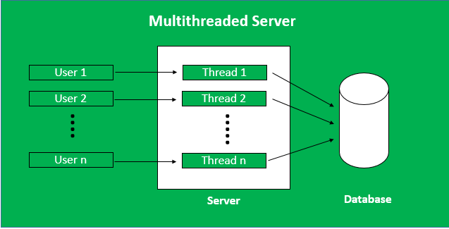
4.4 - Threads in Server-Based Applications
IGOR SYRYTSIN, CAOS, SW4 2024

Slide 54
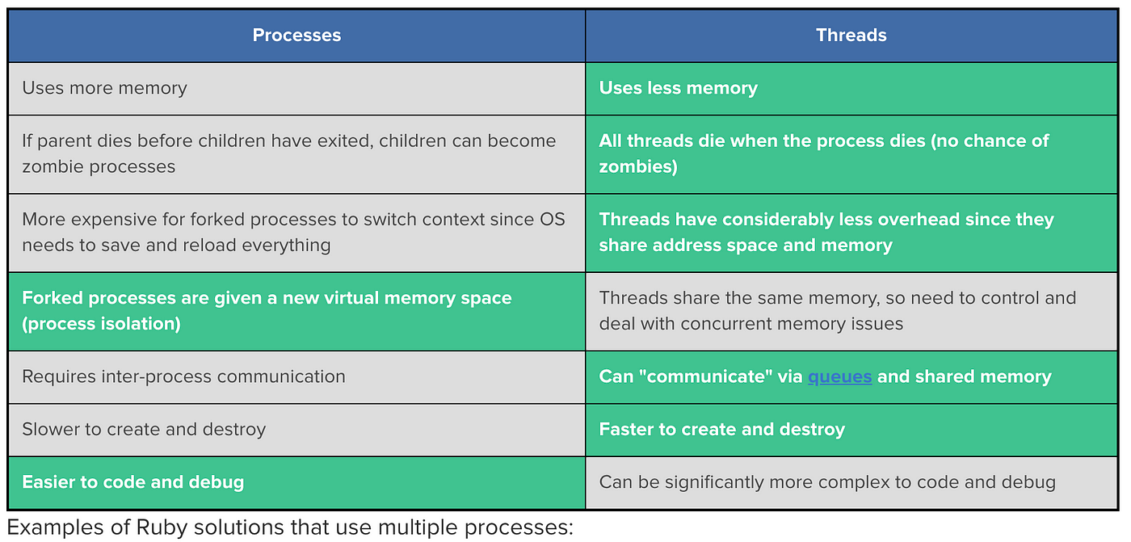
4.5 - Threads vs. Multiple Processes
IGOR SYRYTSIN, CAOS, SW4 2024

Slide 55
4.6 - Choosing between threads and processes
Processes:
Operating System Services: Services like logging, monitoring, or network management may run as background processes to ensure they are isolated and do not interfere with each other, which enhances security and stability.
Batch Processing Jobs: These are typically run as separate processes to utilize multiple cores or CPUs, allowing them to run in parallel without affecting the performance of other services on the system.
Scientific Computing: Processes are commonly used in high-performance computing applications where large datasets are processed in parallel across multiple CPUs or machines, often using message passing interfaces for communication
Graphics Rendering: Graphics-intensive applications, such as video games or simulation software, may use threads to separate rendering from computation to maintain high frame rates and responsive user interaction.
Threads:
Web Servers: Web servers often use threads to handle incoming client requests. Threads share the same memory space and are lighter than processes, enabling the server to handle multiple requests efficiently.
Database Servers: Similar to web servers, database servers may use threading to manage concurrent connections and queries, providing quick responses to multiple database clients
Real-time Systems: In real-time applications, like those used for control systems or robotics, threads can be used to handle different tasks like sensor reading, data processing, and actuator control, all within the same process to facilitate quick data sharing and real-time response.
Mobile Applications: Apps often use threads to perform background tasks such as data fetching or database writing without freezing the user interface, which runs on the main thread.
IGOR SYRYTSIN, CAOS, SW4 2024

Slide 56
4.7 - Memory sharing considerations
Data Isolation: Processes provide better data isolation as each process has its own address space. This is suitable for tasks that require security and stability.
Data Sharing: Threads share memory within the same process, making data sharing more straightforward and efficient. This is ideal for applications that require quick communication between threads.
Synchronization Overhead: With threads sharing memory, there's a need for synchronization mechanisms to avoid race conditions, which may introduce overhead. Processes do not share memory by default, so they may require other inter-process communication (IPC) techniques, which can be more complex and slower but inherently avoid some concurrency issues.
System Resources: Processes are more resource-intensive than threads. If an application requires a lot of parallel tasks, using threads might be more resource-efficient.
Scalability: Memory sharing via threads can be more scalable within a single system. However, when scaling across systems, processes might be preferred, as they do not share memory and can run independently on different machines.
Concurrency Model: The choice might be influenced by the programming language's concurrency model. Some languages and runtimes favor threads (e.g., Java), while others might encourage processes (e.g., Erlang, Golang).
Performance: Shared memory and threads can lead to better performance due to faster data access and lower context switch overhead. However, the potential for contention and complex synchronization logic can mitigate these advantages.
Reliability: A fault in one process does not affect other processes, but a fault in one thread can potentially bring down the entire process due to shared memory.
Complexity: Using shared memory with threads can make an application more complex due to the need for synchronization. This complexity can lead to errors that are hard to detect and fix.
Programming Paradigms: Some programming paradigms, like Object-Oriented Programming, might encourage encapsulation and separation of data which can fit well with processes, whereas Functional Programming might encourage immutability which can simplify thread-based memory sharing.
IGOR SYRYTSIN, CAOS, SW4 2024

Slide 57
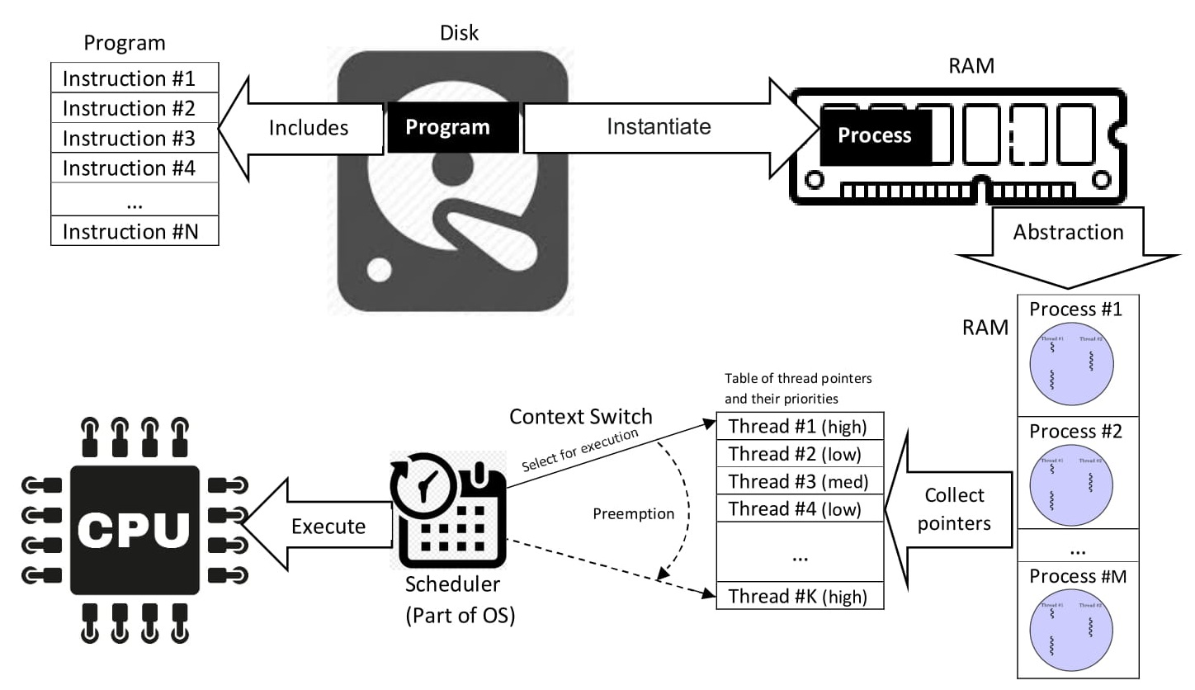
5 - Conclusion and Key Takeaways
Program Lifecycle: Programs stored on disk are instantiated as processes in RAM, with the process serving as an abstraction layer between the program and physical resources.
Process Abstraction: Processes encapsulate the program's instructions and state, allowing the CPU to manage execution in a structured way.
Thread Management: Within each process, multiple threads can be created, each potentially running different instructions of the same program. Threads within the same process can be prioritized and managed independently.
CPU Execution: The CPU executes threads based on the schedule determined by the OS's scheduler, which can preempt the currently running thread to switch context to another as needed.
Context Switching: The ability of the system to switch the CPU's focus from one thread to another ensures efficient use of CPU time, especially when threads are waiting for I/O or other resources.
Resource Utilization: The illustration highlights the optimized use of RAM and CPU resources by abstracting programs into processes and efficiently scheduling threads for execution.
IGOR SYRYTSIN, CAOS, SW4 2024

